Slide 1


UNLEASHING THE POWER OF FORMS, MEDIA, AND ACCESSIBILITY IN FLUTTER
A Comprehensive Guide to Building User-Centric Applications
Notes:
Hello everyone, welcome to our session on "Unleashing The Power of Forms, Media and Accessibility in flutter." In this presentation We will cover Forms and user input, Essential Form Widgets, Form validation, Ensuring Data Integrity, Custom validation methods, Displaying error using UI, Working with Media, Flutter Building Adaptive apps and Flutter Accessibility in apps

Slide 2

Introduction to Forms and User Input
Crafting Effective Forms
Forms are essential for gathering user input and driving app functionality
Flutter provides a rich collection of form widgets for various input types
Building intuitive forms enhances user experience and data collection
Notes:
Crafting Effective Forms
Forms are essential for gathering user input and driving app functionality
Flutter provides a rich collection of form widgets for various input types
Building intuitive forms enhances user experience and data collection

Slide 3
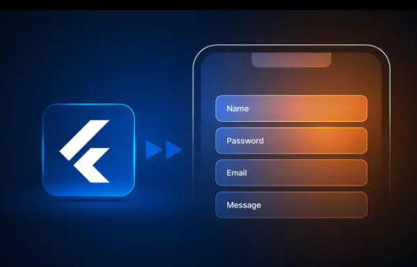
ESSENTIAL FORM WIDGETS
TextField
Checkbox
RadioButton
Slider
DropdownButton
Notes:
TextField
Checkbox
RadioButton
Slider
DropdownButton

Slide 4
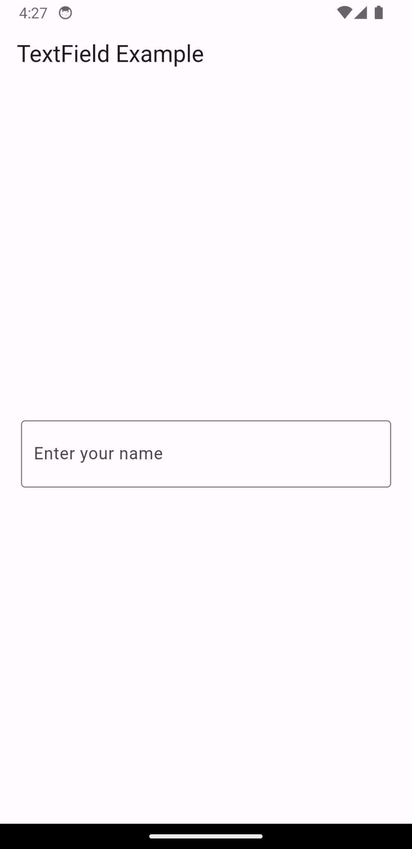
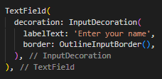
TextField
Notes:
TextField: Capturing text input from users

Slide 5
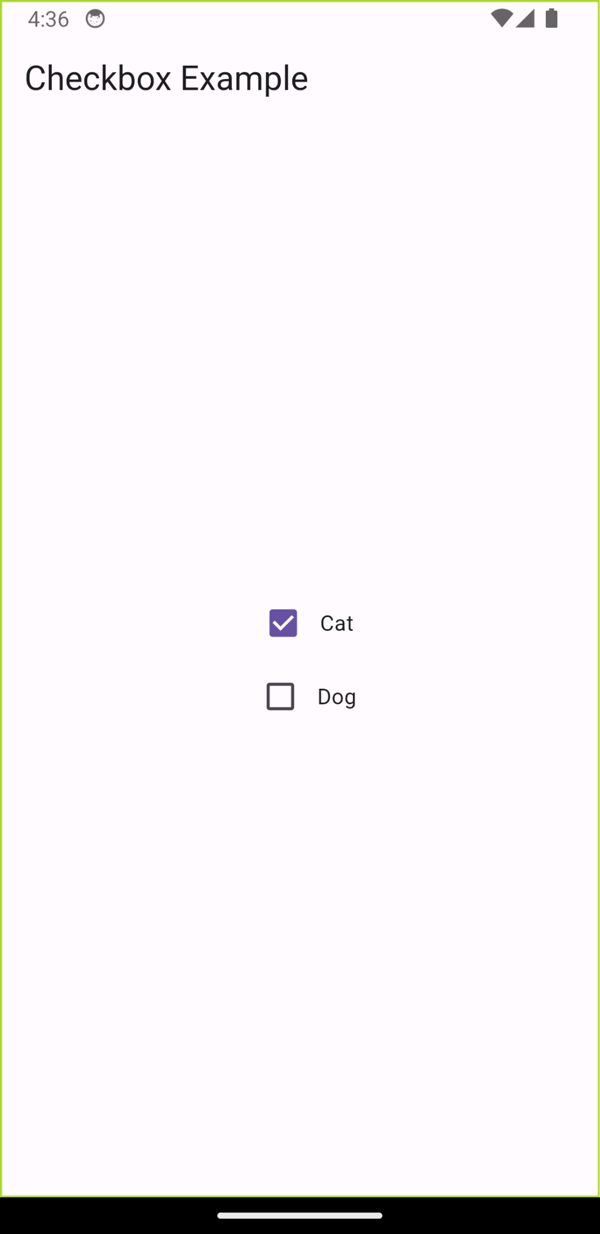
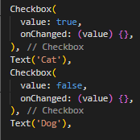
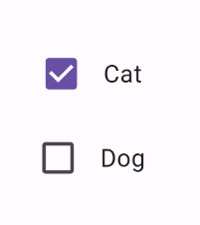
Checkbox
Notes:
Checkbox: Enabling multiple selections from a set of options

Slide 6
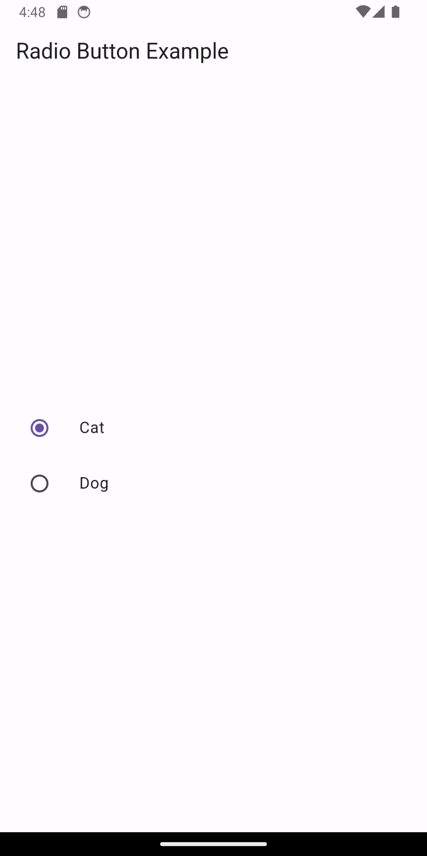
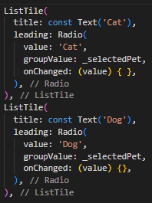
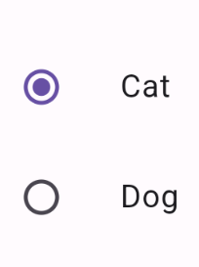
RadioButton
Notes:
RadioButton: Selecting a single option from a group of choices

Slide 7
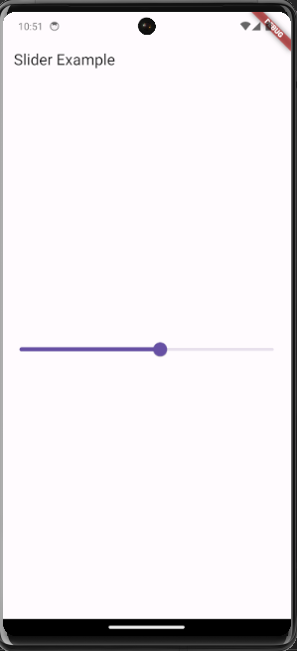
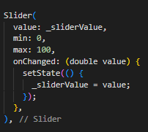
Slider
Notes:
Slider: Choosing a value from a continuous range

Slide 8
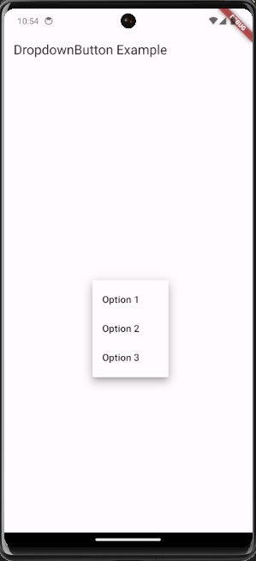
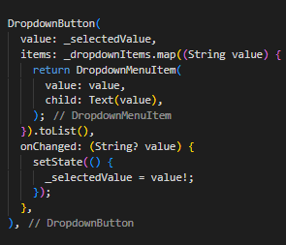
DropdownButton
Notes:
DropdownButton: Selecting an item from a list of options

Slide 9

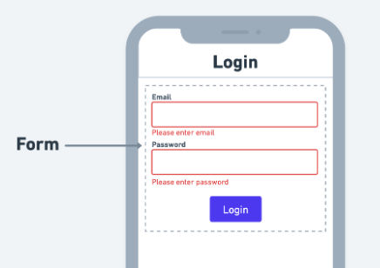
FORM VALIDATION
Form validation in Flutter involves checking whether the information entered by the user in a form is correct and meets certain criteria, such as filling all required fields or providing valid data.
Ensuring Data Integrity
Custom Validation Methods
Displaying Error Using UI
Notes:
What is Form Validation?
Form validation in Flutter involves checking whether the information entered by the user in a form is correct and meets certain criteria, such as filling all required fields or providing valid data.

Slide 10

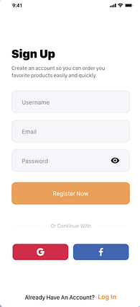
Ensuring Data Integrity
Form validation in Flutter ensures accurate user input by enforcing rules and preventing invalid data submission.
Notes:
Ensuring Data Integrity:
Form validation plays a crucial role in guaranteeing accurate and complete user input
Flutter offers various validation techniques to enforce input rules and prevent invalid data submission

Slide 11
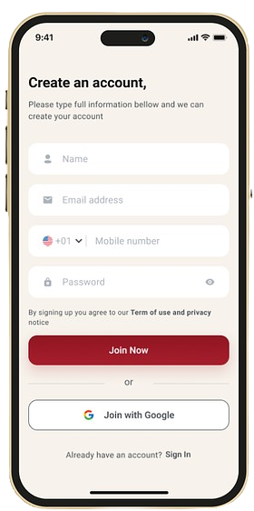
Custom Validation Methods
Custom Validation Methods
Implement custom validation logic to handle specific input requirements
Validate input patterns, lengths, and data formats
Display error messages to guide users towards valid input
Notes:
Custom Validation Methods:
Implement custom validation logic to handle specific input requirements
Validate input patterns, lengths, and data formats
Display error messages to guide users towards valid input

Slide 12
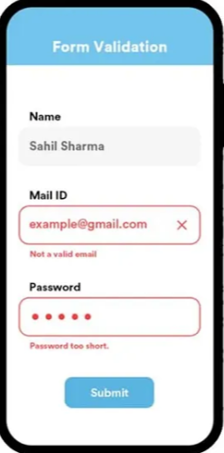
Displaying Error Using UI
Leverage InputDecorations to provide visual feedback during validation
Display error messages and highlight invalid input fields
Enhance user understanding of input errors and improve form usability
Notes:
Displaying Error Using UI
Leverage InputDecorations to provide visual feedback during validation
Display error messages and highlight invalid input fields
Enhance user understanding of input errors and improve form usability

Slide 13





Working with Media (Images, Icons, and Fonts)
Displaying Images
Enhancing with Icons
Customizing Fonts
𝓯𝓵𝓾𝓽𝓽𝓮𝓻
ｆｌｕｔｔｅｒ
ᎦᏝᏬᏖᏖᏋᏒ
.
Notes:
Displaying Images:
Images add visual appeal and convey information effectively in Flutter apps
Display images from various sources, including assets, network, and external storage
Utilize Image widget to manage image properties, resizing, and applying filters
Enhancing with Icons:
Icons provide a concise and consistent way to represent actions, concepts, and objects
Integrate icons from Font Awesome, Material Icons, and custom icon fonts
Use Icon widget to display icons and customize their appearance
Customizing Fonts:
Fonts play a significant role in establishing the app's brand identity and enhancing readability
Manage app fonts using FontFamily and TextTheme
Customize font families, sizes, weights, and styles to achieve desired visual effects

Slide 14

Flutter - Building Adaptive Apps
.
Adapting to Diverse Screens:
Adaptive design ensures a se
amless user experience across various screen sizes and orientations
Utilize Media Queries to respond to device dimensions and adapt layouts accordingly
Create responsive UIs that scale gracefully for different devices
Notes:
Adapting to Diverse Screens:
Adaptive design ensures a seamless user experience across various screen sizes and orientations
Utilize Media Queries to respond to device dimensions and adapt layouts accordingly
Create responsive UIs that scale gracefully for different devices

Slide 15
Flutter - Accessibility In Apps
.
Embracing Accessibility:
Accessibility makes Flutter apps inclusive and usable for people with disabilities
Employ semantic widgets like Text, Image, and Button for accessibility
Implement features like screen readers and color contrast adjustments
Notes:
Embracing Accessibility:
Accessibility makes Flutter apps inclusive and usable for people with disabilities
Employ semantic widgets like Text, Image, and Button for accessibility
Implement features like screen readers and color contrast adjustments

